Slide 1
Electronics Lab (Experiment-1A)
P . Manoj Kumar
Roll no : 21IE10027

Slide 2
DC Characterization of Bipolar Junction Transistor
Objective of the Experiment
To observe I-V characteristics of a bipolar junction transistor.
To extract values of device model parameters from the observed I-V characteristics.

Slide 3
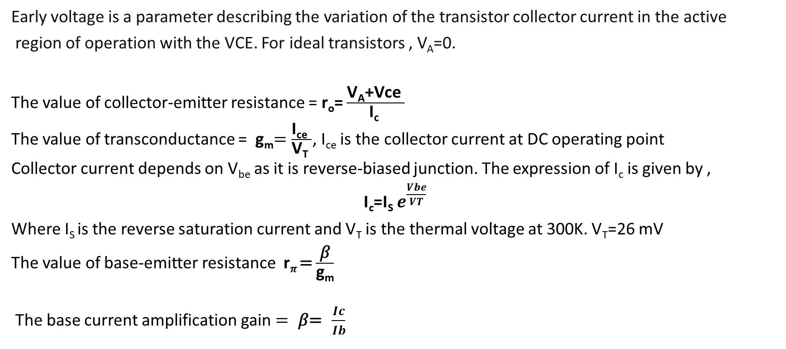
Theory
Early voltage is a parameter describing the variation of the transistor collector current in the active
region of operation with the VCE. For ideal transistors , V_{A}=0.
The value of collector-emitter resistance = r_{o}= $\frac{\text{V}\text{A}\text{+}\text{Vce} }{\text{I}\text{c} }$
The value of transconductance = g_{m}$=\frac{\text{I}\text{ce} }{\text{V}\text{T} }$, I_{ce} is the collector current at DC operating point
Collector current depends on V_{be} as it is reverse-biased junction. The expression of I_{c} is given by ,
I_{c}=I_{S} $e^{\frac{Vbe}{VT}}$
Where I_{S} is the reverse saturation current and V_{T} is the thermal voltage at 300K. V_{T}=26 mV
The value of base-emitter resistance r_{𝜋} = $\frac{\text{β}}{\text{g}\text{m}}$
The base current amplification gain $= \text{β}\text{= }\frac{Ic}{Ib}$

Slide 4
List of Components
SL No. | Component | Rating | Quantity
1 | BJT transistor | 2N2222 | 1
2 | Battery | 12V | 2
3 | Resistors | 5𝛺,100𝛺,200𝛺,300𝛺, 100k𝛺,200k𝛺,300k𝛺 | 8
4 | Connecting Wires | - | -

Slide 5
Procedure
Both the circuits were drawn in LTSpice.
In the first circuit , the collector-emitter voltage was varied and the output characteristics was plotted with three different values of base current. ( Here the base current was changed by taking three different values of R_{b} ) . The values of asked parameters were calculated.
In the second circuit , the base-emitter voltage was varied and the trans-characteristics and input-characteristics were plotted by taking R_{b} value as 300k𝛺 and the values of asked parameters were calculated.
Then the trans-characteristics and input-characteristics were combined and I_{c} vs I_{b} characteristics was plotted . The values of gains were calculated .

Slide 6
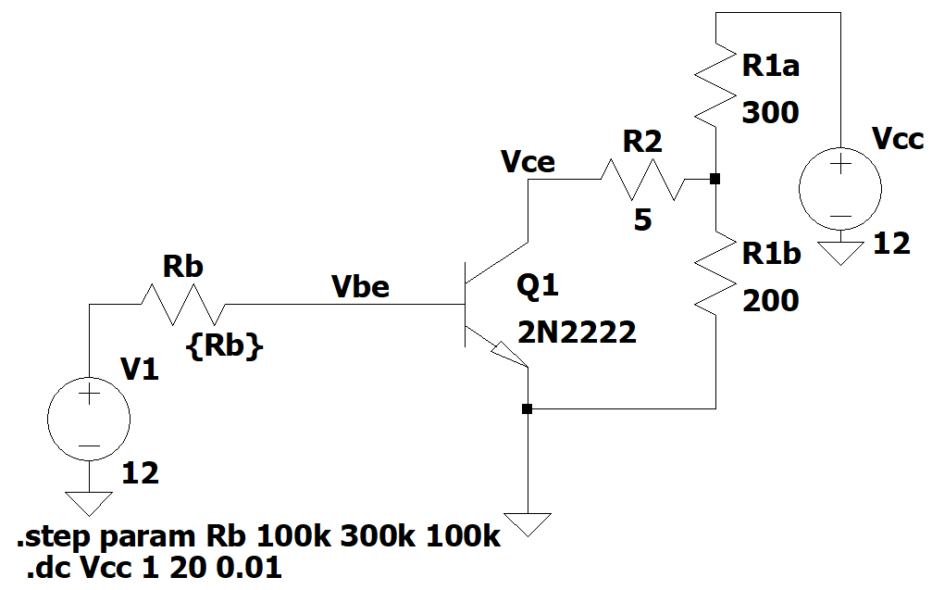
Circuit Diagram-1
Fig-1.1- BJT circuit diagram
The value of R_{b} was varied from 100k𝛺 to 300k𝛺 by 100k𝛺.

Slide 7
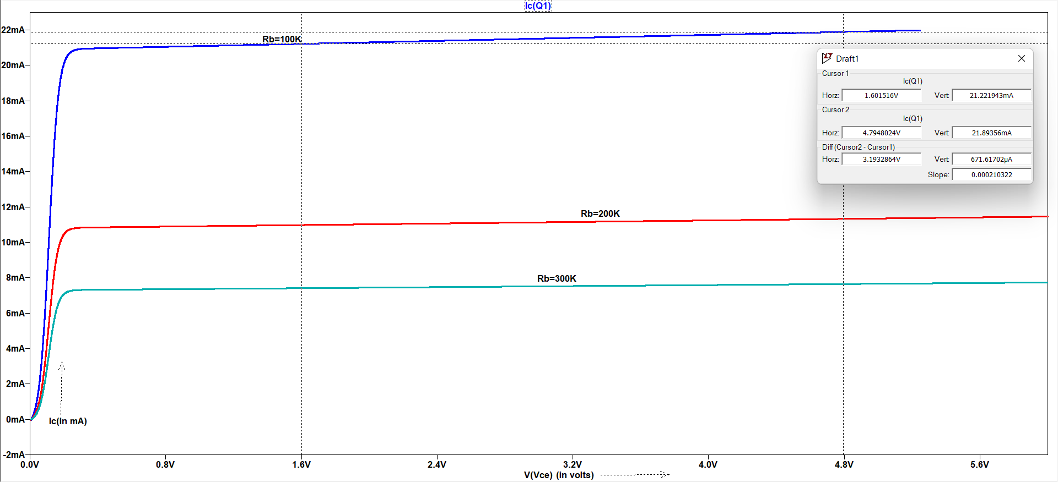
Graph-1.1
Fig-1.2-Output Characteristics (I_{c} vs V_{ce}) of BJT for three different values of Rb
For early voltage calculation, two points on the graph (Rb=100k) were chosen.

Slide 8
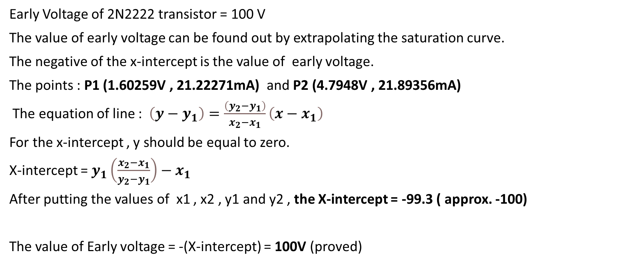
Calculations-1.1
Early Voltage of 2N2222 transistor = 100 V
The value of early voltage can be found out by extrapolating the saturation curve.
The negative of the x-intercept is the value of early voltage.
The points : P1 (1.60259V , 21.22271mA) and P2 (4.7948V , 21.89356mA)
The equation of line : $\left(y−y_{1}\right)=\frac{\left(y_{2}−y_{1}\right)}{x_{2}−x_{1}}\left(x−x_{1}\right)$
For the x-intercept , y should be equal to zero.
X-intercept = $y_{1}\left(\frac{x_{2}−x_{1}}{y_{2}−y_{1}}\right)−x_{1}$
After putting the values of x1 , x2 , y1 and y2 , the X-intercept = -99.3 ( approx. -100)
The value of Early voltage = -(X-intercept) = 100V (proved)

Slide 9
Calculations-1.1
The values of V_{ce} and I_{c} were calculated from the operating point analysis for
three different values of Rb.
Value of Rb (in k𝝮) | V_{ce} (in volts) | I_{c} (in A) | r_{o} (in k𝝮)
100 | 2.1332 | 0.0213344 | 4.787
200 | 3.40298 | 0.0111762 | 9.252
300 | 3.85274 | 0.00757806 | 13.704

Slide 10
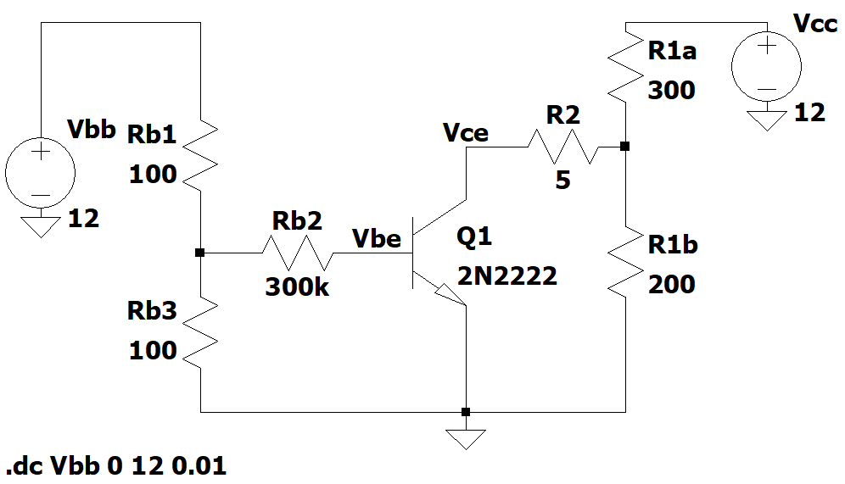
Circuit Diagram-2
Fig-2.1- BJT Circuit Diagram

Slide 11
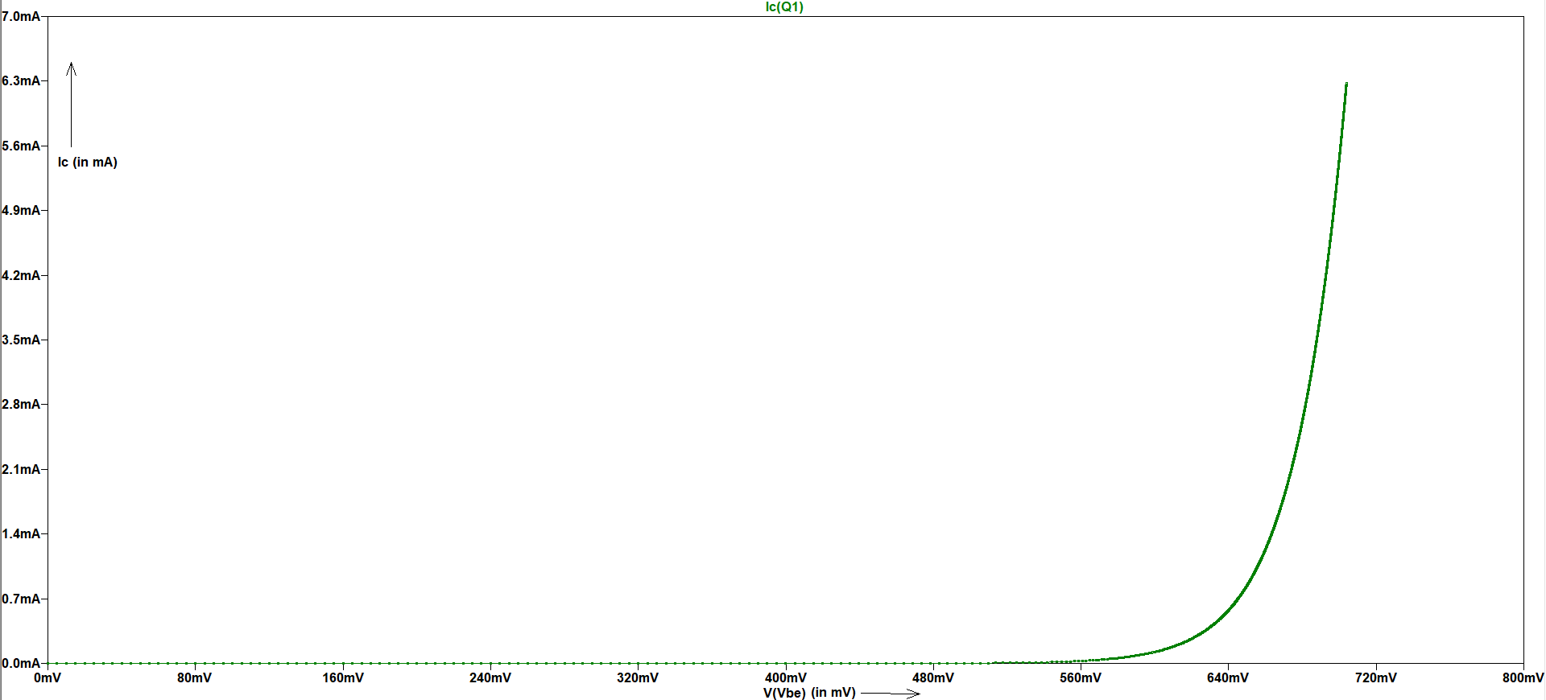
Graph-2.1
Fig-2.2- Trans-characteristics (I_{c} vs V_{be}) of BJT
The characteristics is same as the I-V characteristics of PN Junction in forward-bias region.

Slide 12

Calculations-2.1
The value of collector current at DC operating point = 3.62741 mA
The value of transconductance = g_{m}$=\frac{\text{I}\text{c} }{\text{V}\text{T} }= \frac{0.00362741}{0.026}=0.1395Ω^{−1}$

Slide 13
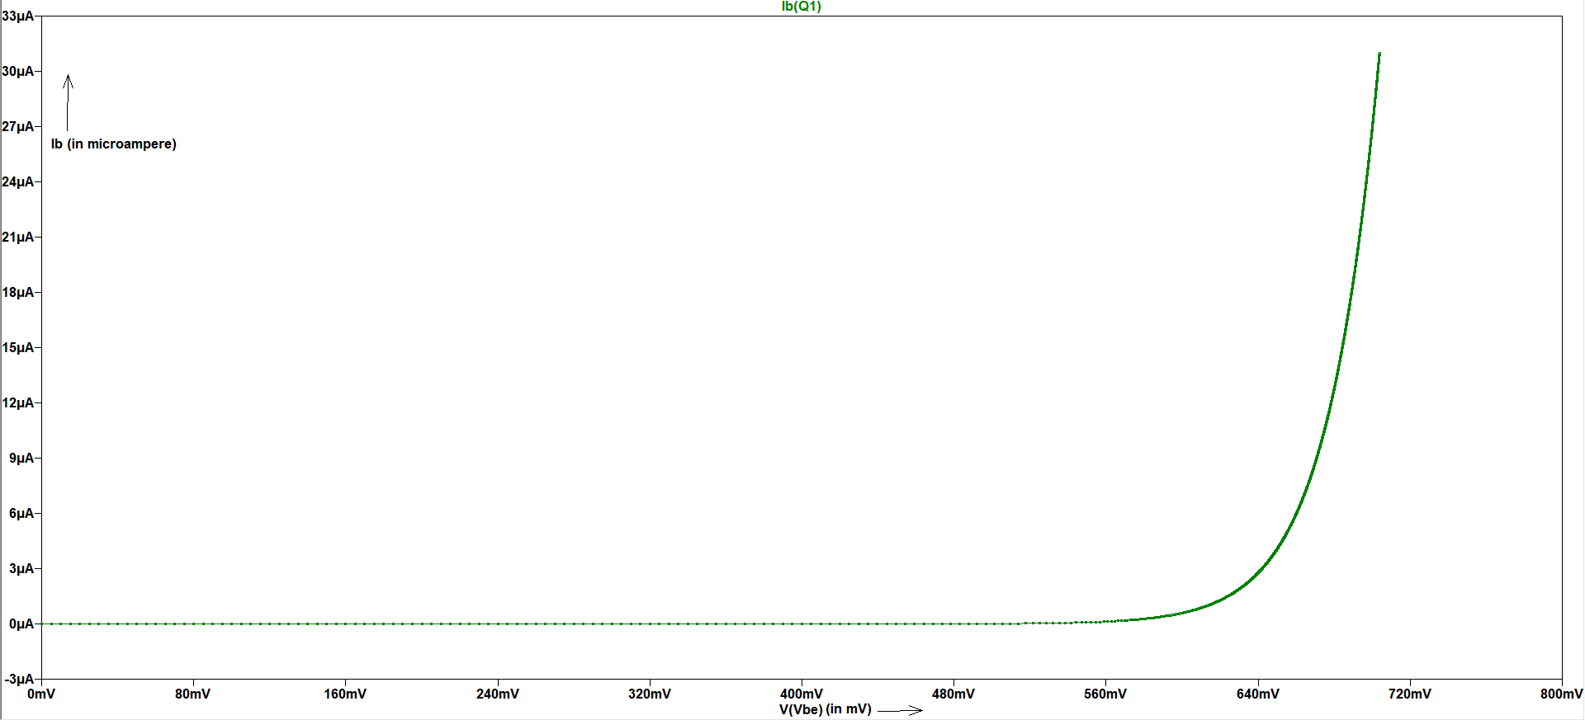
Graph-2.2
Fig-2.3- Input Characteristics (I_{b} vs V_{be}) of BJT
The characteristics is same as the I-V characteristics of PN Junction in forward-bias region.

Slide 14
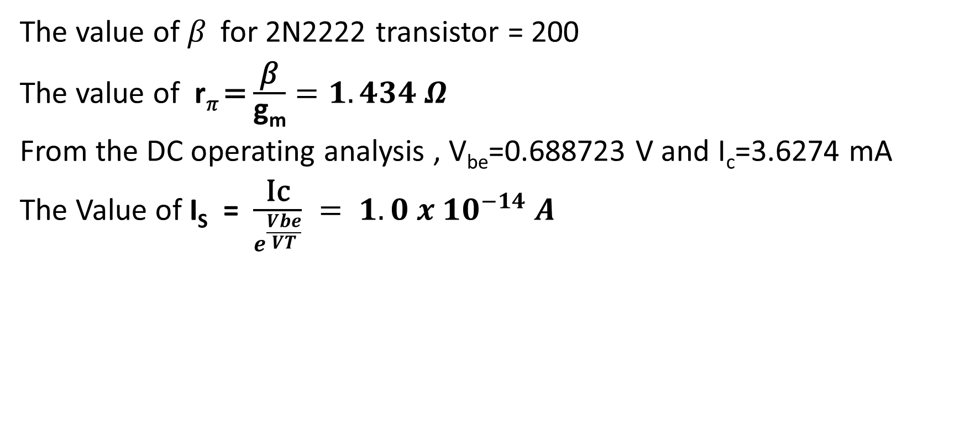
Calculations-2.2
The value of 𝛽 for 2N2222 transistor = 200
The value of r_{𝜋} = $\frac{\text{β}}{\text{g}\text{m}}=1.434 Ω$
From the DC operating analysis , V_{be}=0.688723 V and I_{c}=3.6274 mA
The Value of I_{S} = $\frac{\text{Ic}}{e^{\frac{Vbe}{VT}}} = 1.0 x {10}^{−14} A$

Slide 15
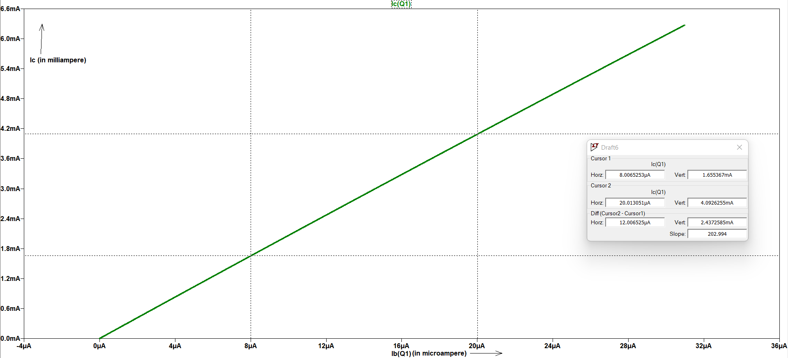
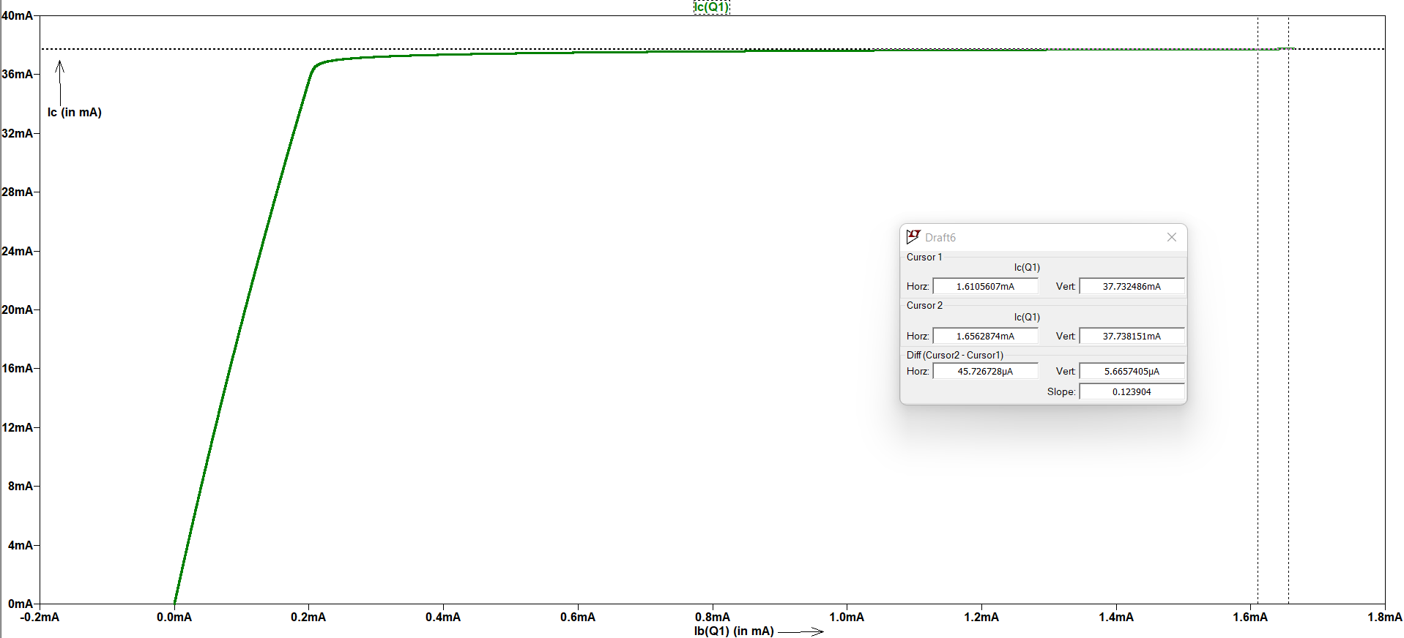
Graph-2.3
Fig-2.4- Combination of Trans-characteristics and Input characteristics of BJT
The plot ( I_{c} vs I_{b}) is straight line for small values of I_{b} .
The small signal current gain can be found by simply finding the slope of the curve .
For large values of base current , the collector current doesn’t change and
the collector current reaches to the maximum value.

Slide 16
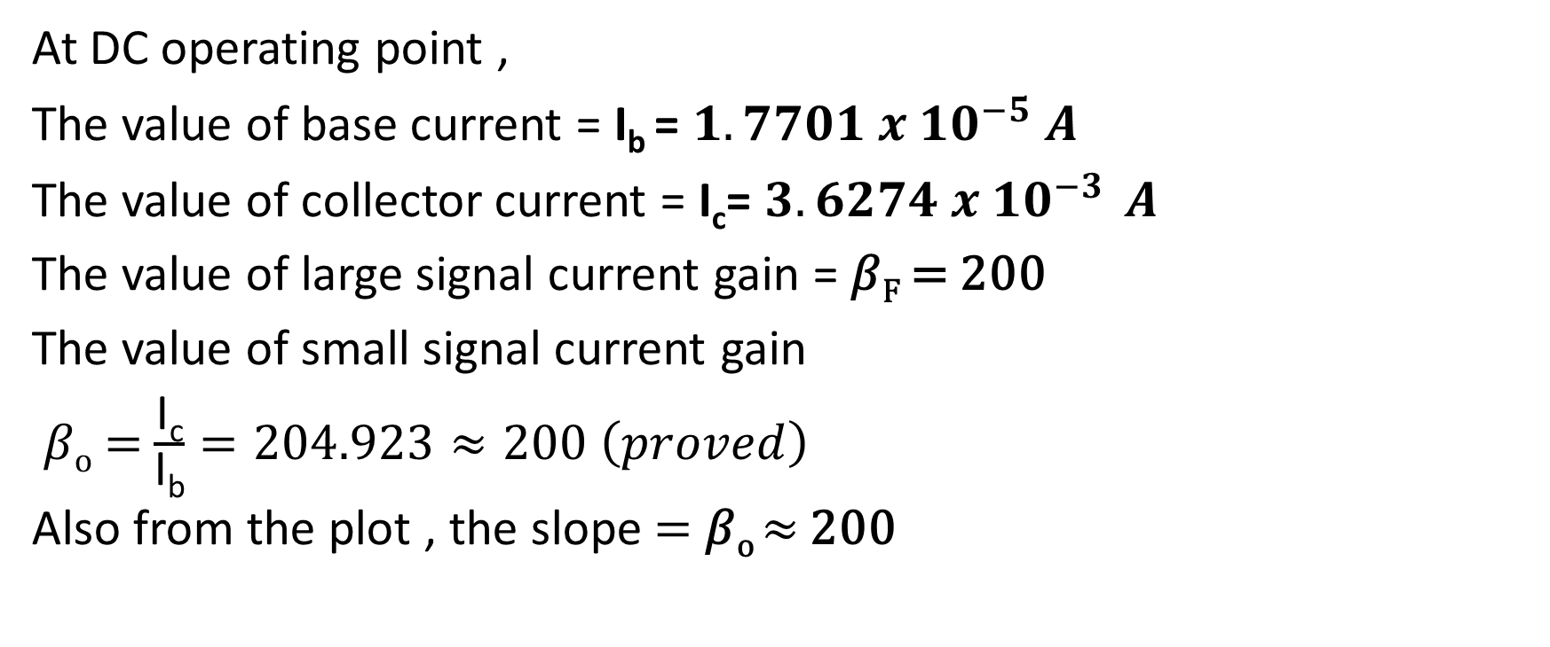
Calculations-2.3
At DC operating point ,
The value of base current = I_{b} = $1.7701 x {10}^{−5} A$
The value of collector current = I_{c}= $3.6274 x {10}^{−3 } A$
The value of large signal current gain = 𝛽_{F} = 200
The value of small signal current gain
𝛽_{o} = $\frac{\text{I}\text{c}}{\text{I}\text{b}}=204.923≈200 \left(proved\right)$
Also from the plot , the slope = 𝛽_{o} $≈$ 200

Slide 17
Observations
A very high resistance R_{b} is used to prevent the transistor from burning out .
The collector current becomes constant for larger values of base current .

